Slide 1
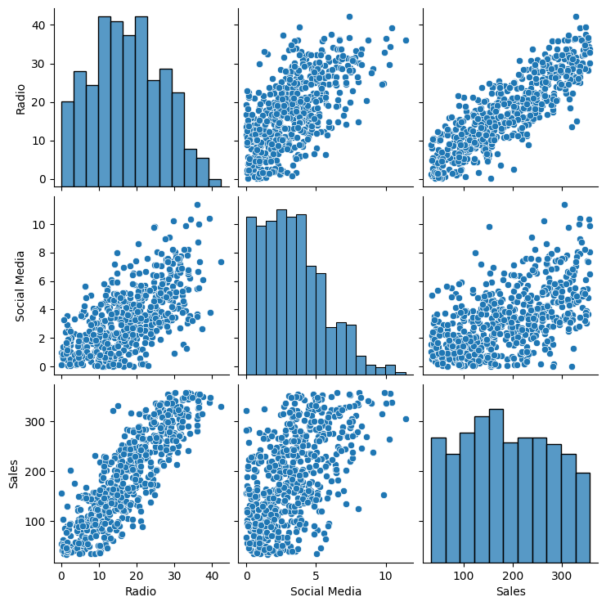
Multiple Linear Regression Analysis Executive Summary Report Prepared by Robes Fokoueng – March 2024
Project Overview
We want to explore the relationship between Two or more different marketing promotional budgets and sales. This will help the leaders to make decisions about where to focus future marketing effort.
Key Insights
TV and Radio was selected because they have a strong relationship with sales.
Using TV and Radio as the independent variables results in a multiple linear regression model with R2 = 0.904.
According to the model, high TV promotional budgets result in significantly more sales than medium and low TV promotional budgets.
The coefficient for radio (2.9669) is positive, confirming the positive linear relationship.
The p-value for all coefficients is 0.000, meaning all coefficients are statistically significant at p = 0.05.
Details
Radio has the strongest linear relationship with sales.
Recommendations
High TV promotional budgets have a substantial positive influence on sales. The model estimates that switching from a high to medium TV promotional budget reduces sales by $75.3120 million (95% confidence intervals [−82.431, −68.193]), and switching from a high to low TV promotional budget reduces sales by $154.297 million (95% confidence intervals [−163.979, −144.616]). The model also estimates that an increase of $1 million in the radio promotional budget will yield a $2.9669 million increase in sales (95% confidence intervals [2.551, 3.383]).
Thus, it is recommended that the business allot a high promotional budget to TV when possible and invest in radio promotions to increase sales.
Next Steps
Providing the business with the estimated sales given different TV promotions and radio budgets.

